Slide 1
Gerald Versluis
@jfversluis
6 October 2017
Skynet activated
Building smarter apps with Cognitive Services and Xamarin
Notes:
https://github.com/BrianPeek/NotHotdogFunc

Slide 2




Who is this Dutch guy?!
Gerald Versluis
@jfversluis
blog.verslu.is
gerald@verslu.is

Slide 3
Who is this Dutch guy?!
Gerald Versluis
@jfversluis
blog.verslu.is
gerald@verslu.is

Slide 4
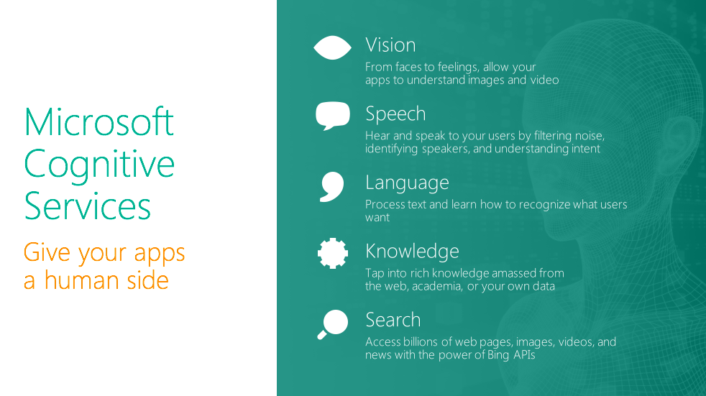

Slide 5
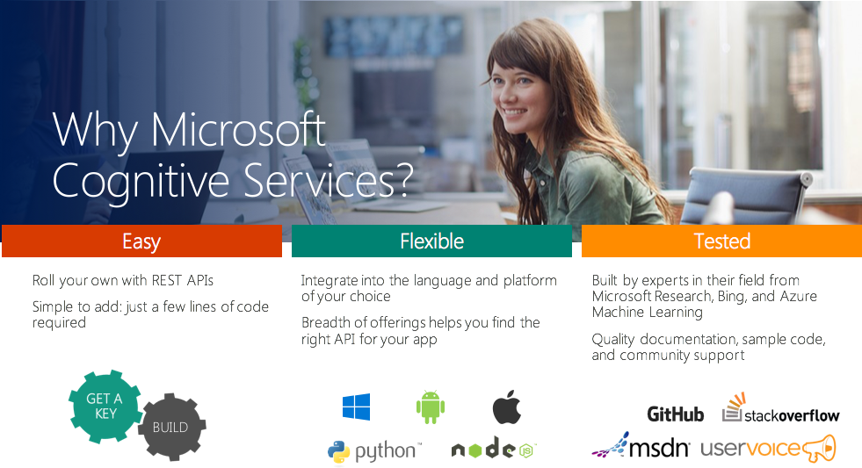
Notes:
Mobile devices are very suited for cognitive services. It has a camera, microphone, speaker, etc.

Slide 6
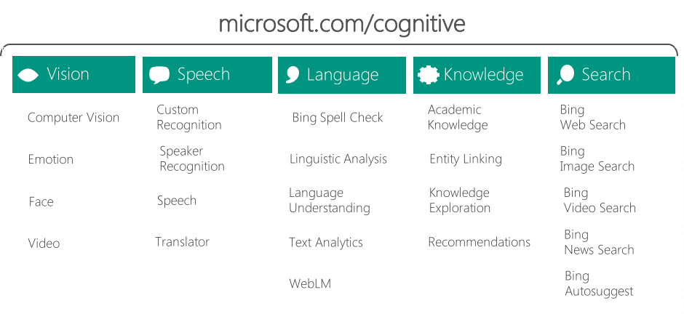
Cognitive Services

Slide 7
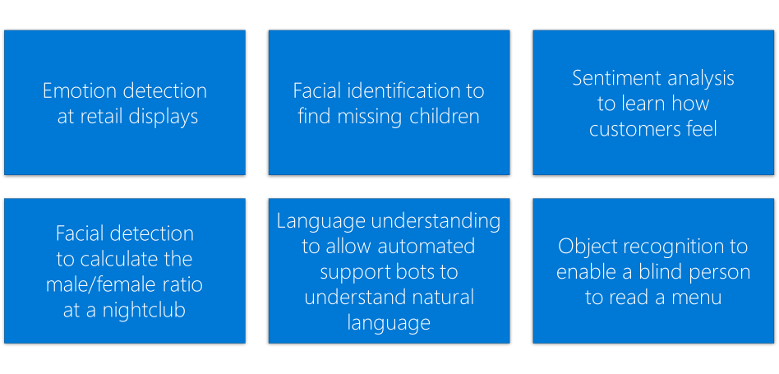
Possible Scenarios

Slide 8
Working with Cognitive Services
{
"tags": [
{ "name": "Terminator",
"score": 0.976 },
{ "name": “Arnold",
"score": 0.95 } ],
"description":
{ "tags":
[ “terminator", "arnold" ],
"captions": [
{ "text”: “Killer robot
from the future”,
“confidence”: 0.96 }
]
}
}
using Microsoft.ProjectOxford.Vision;
using Microsoft.ProjectOxford.Vision.Contract;
AnalysisResult analysisResult;
var features = new VisualFeature[] { VisualFeature.Tags, VisualFeature.Description };
using (var fs = new FileStream(@“C:\Skynet\T-800.jpg”, FileMode.Open))
{
analysisResult = await visionClient.AnalyzeImageAsync(fs, features);
}
POST https://api.projectoxford.ai/vision/v1.0/analyze?visualFeatures=Description,Tags
&subscription-key=<Your subscription key>

Slide 9
Not HotDog
&
ExpenseIt
Demo

Slide 10
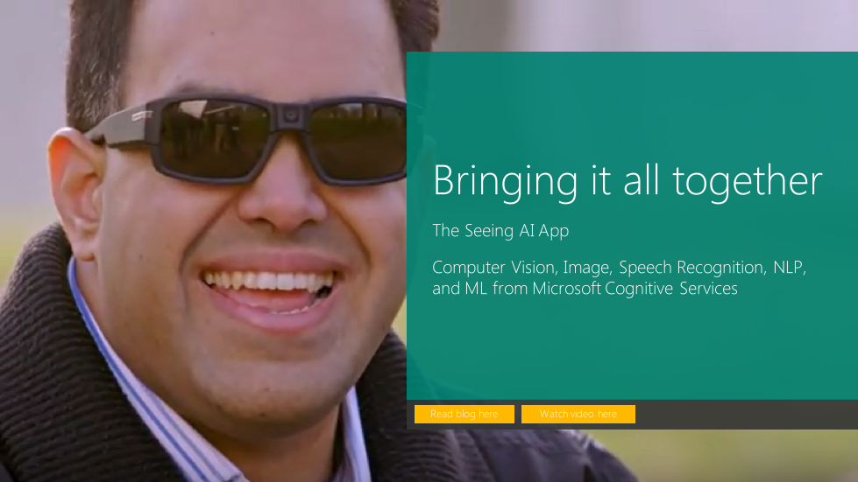
https://www.microsoft.com/en-us/seeing-ai/

Slide 11
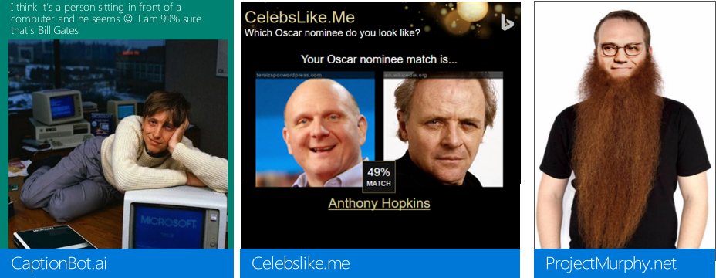
Some Fun Implementations

Slide 12


Slide 13


That’s all folks!
Gerald Versluis
@jfversluis
blog.verslu.is
gerald@verslu.is
Thank you!
December 2017!

